Slide 1
Project Title
Hands on Data Analytics for Everyone Project Presentation
Session 1005
Group Name:
Member Names:
北京师范大学-香港浸会大学联合国际学院
United International College
Division of Science and Technology / Data Science

Slide 2
Introduction
Business problem to be solved (purpose of the project)
predict insurance costs
What dataset has been used
https://www.kaggle.com/datasets/mirichoi0218/insurance?resource=download
Questions investigated:
The relationship between insurance costs and children & region
The impact of smoking on insurance costs
The relationship between insurance costs and age
The relationship between insurance costs and sex
The relationship between insurance costs and BMI
Current Presenter’s Name

Slide 3
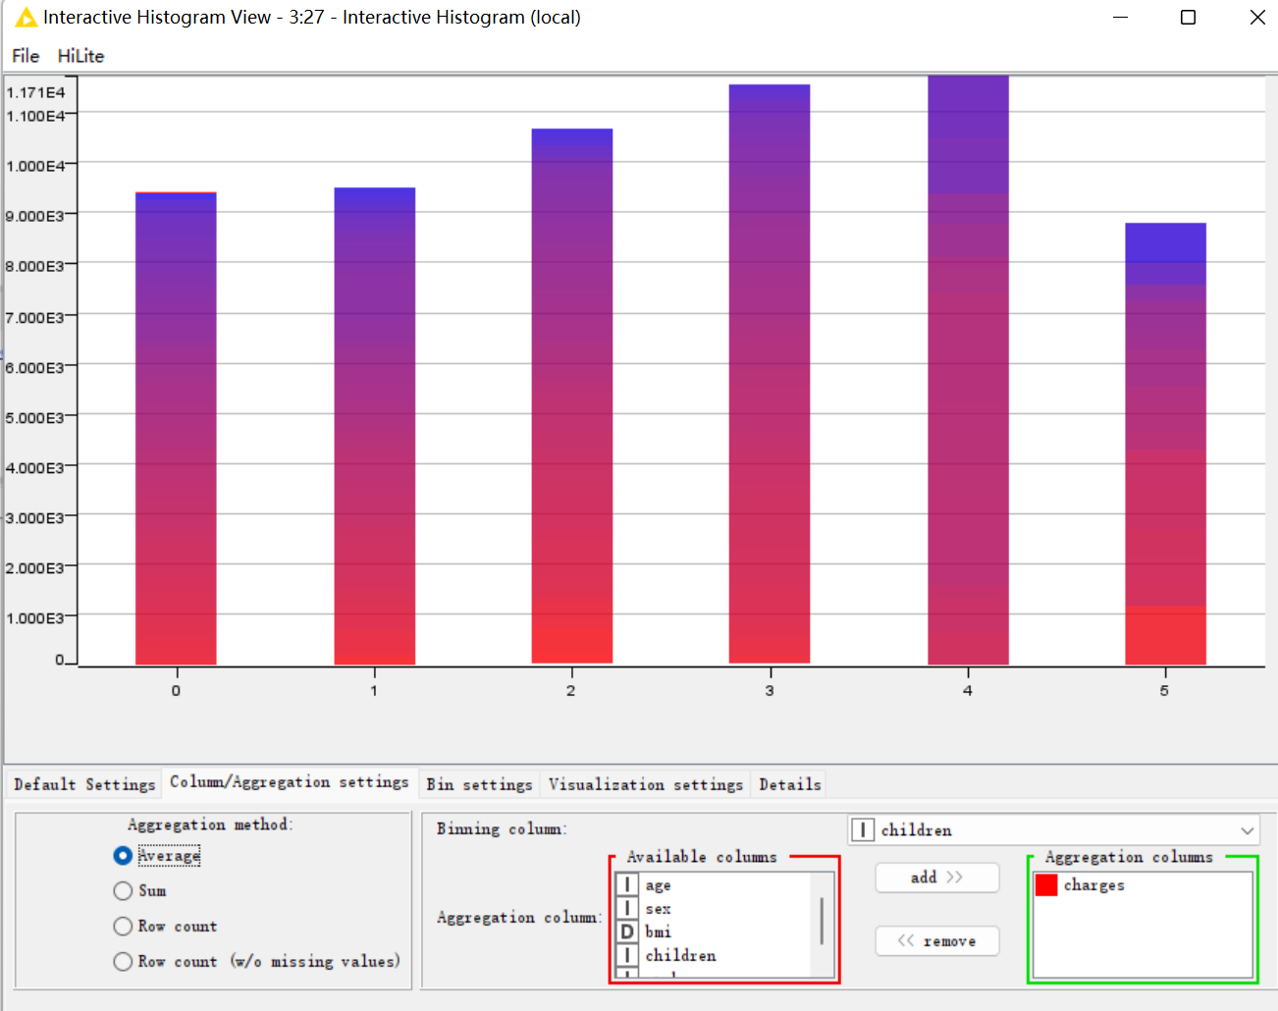
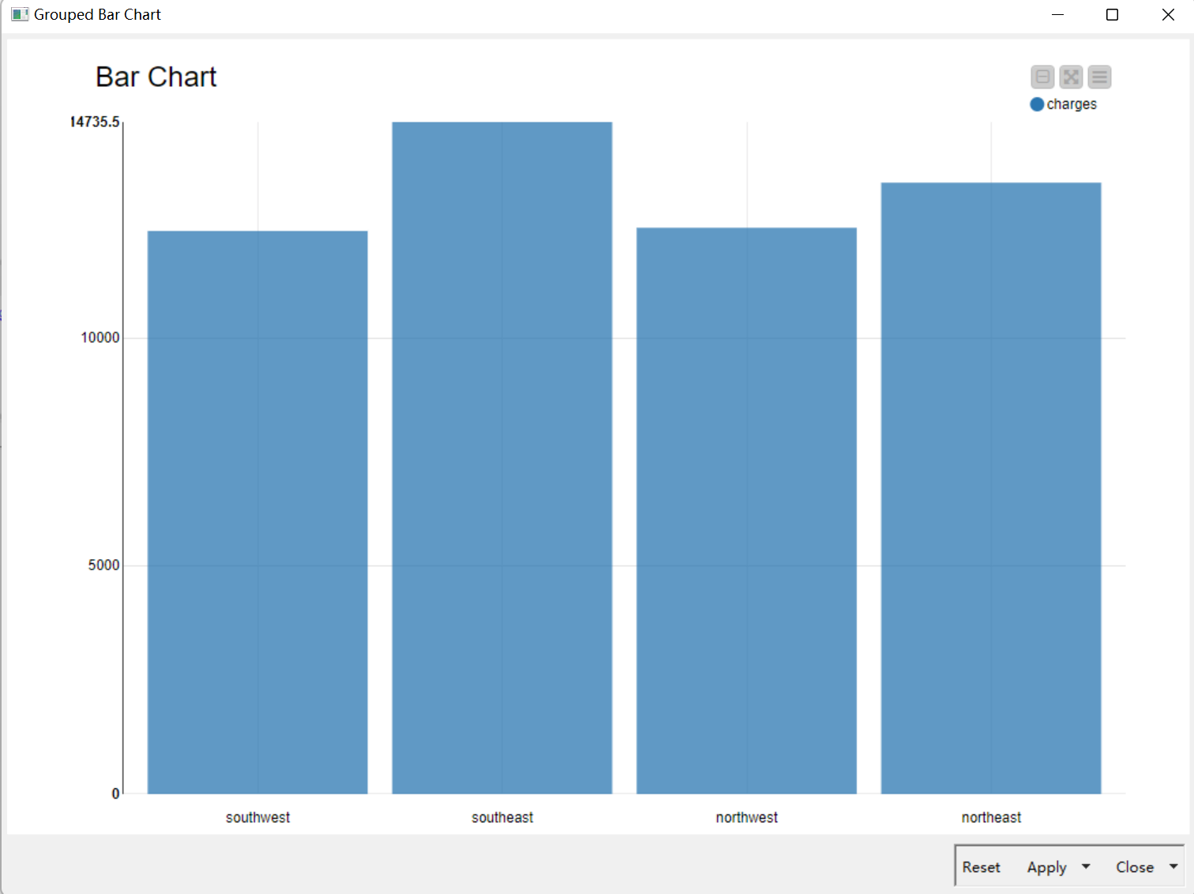
Data Exploration—children & region
We can‘t see the obvious rule from the figure. Relationship between children and charges are in a linear growth at first 4 bins. However, it is abnormal that in the bin 5 the number is decreased.
When buying such insurance, people may give priority not to children but to loans and family expenses.

Slide 4
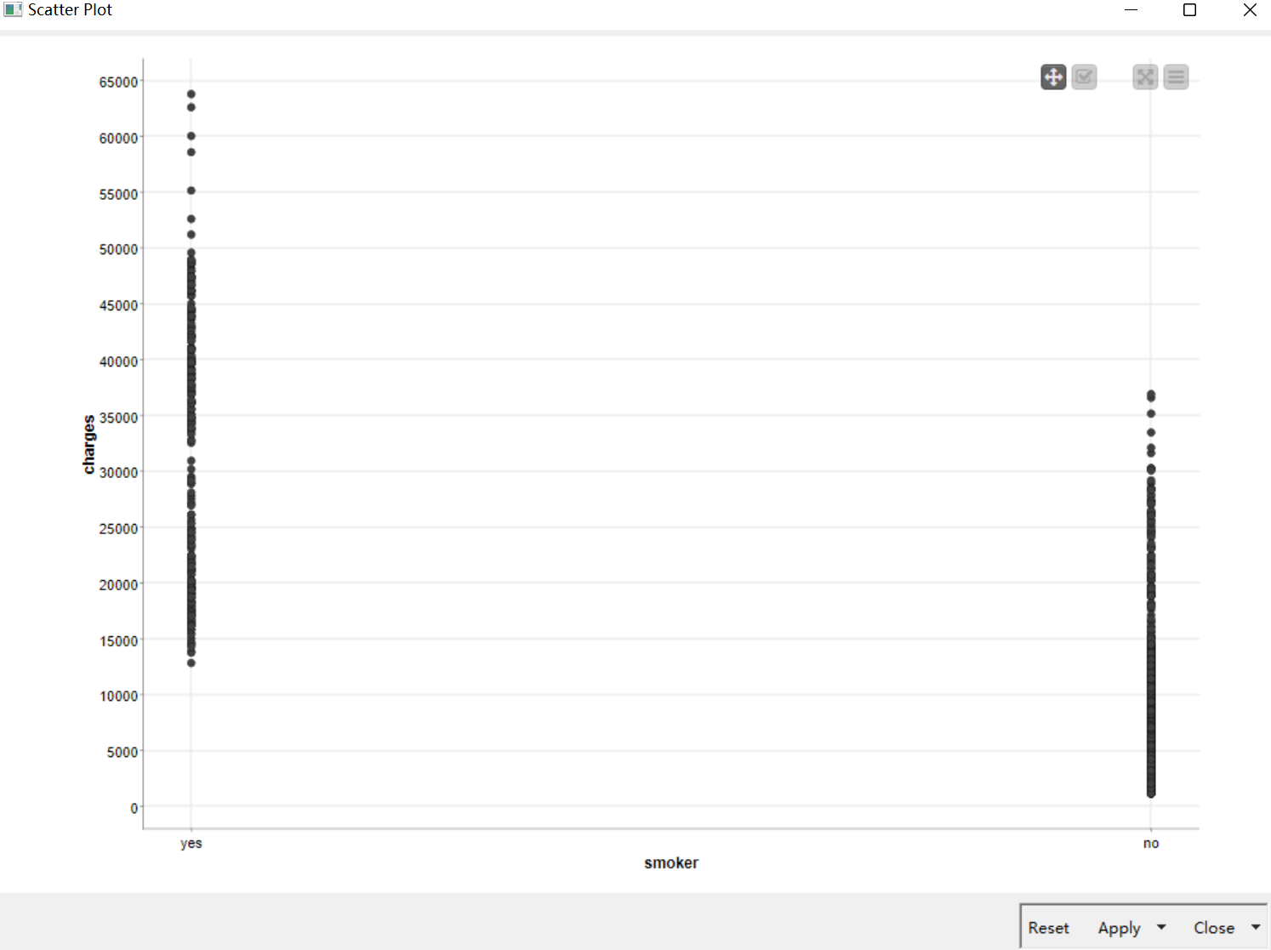
Data Exploration-- smoker
Scatter plot is a good tool to find the influence of the smoking habit to the charges. The smokers’ charges is generally higher than the normal individuals, maybe because of their health problem.

Slide 5
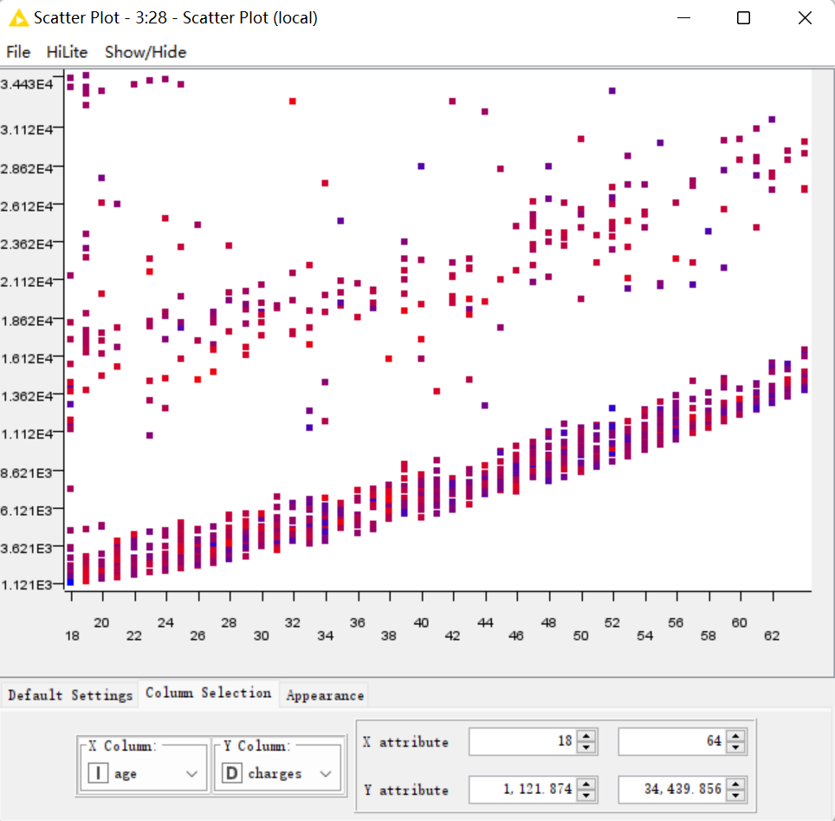
Data Exploration-- age
There is a nearly linear relationship between age and charges.We can see that the older the older the higher the amount of insurance, which is consistent with the fact that older people are more likely to get sick.

Slide 6
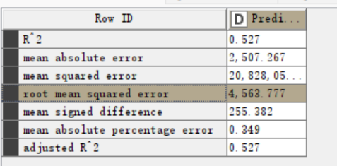
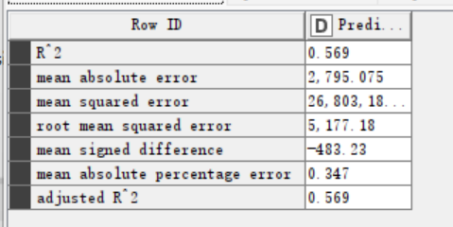
Data Exploration--sex
Initially, we didn’t take sex into our account, because in our common sense, the medical insurance has nothing to do with the insurance price.
With sex：
Without sex:
Obviously, the training set with sex has a more precise result !
Then, we repeat model learning preces and train the model to avoid the error caused by the randomly partitioning.
After many times attempting, we finally find sex had an influence on the accuracy.

Slide 7
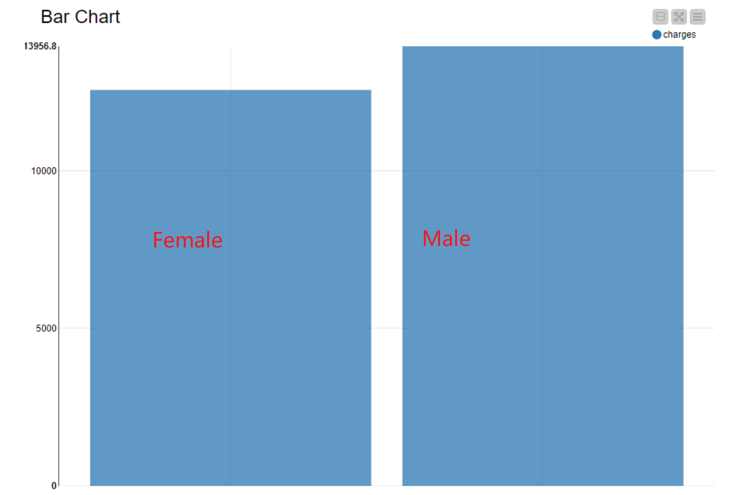
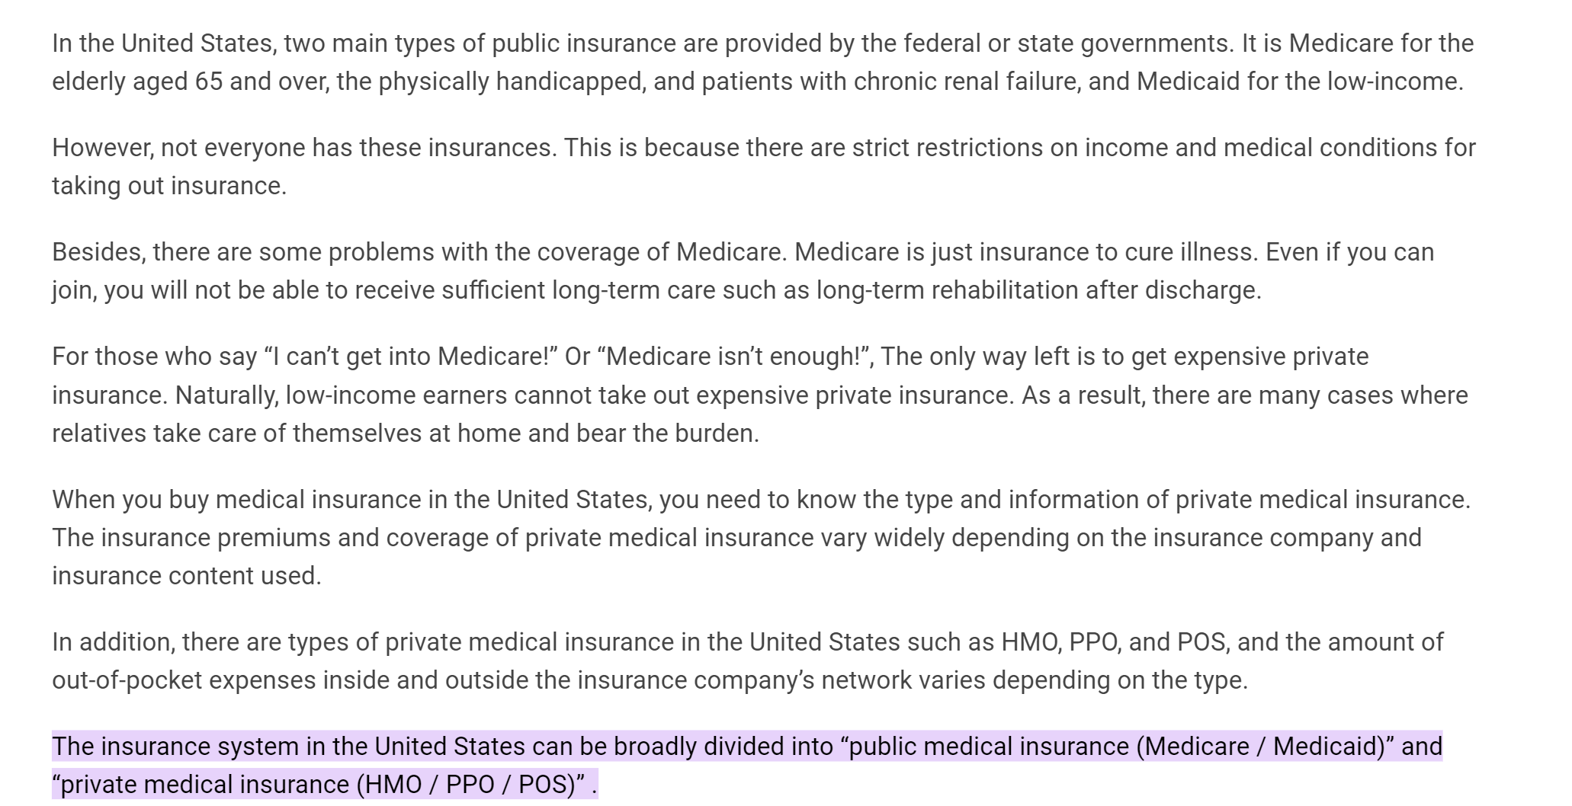
Data Exploration--sex
Male’s average price is relatively higher than female’s.
However, the number of smokers, average ages and average BMI is nearly the same of female and male, so we don’t think the difference is caused by these attributes.
By searching for the information, we find America’s major insurance system is commercial insurance system, which is affected by different people, so we make a hypothesis that it is the insurance system lead to the difference.

Slide 8
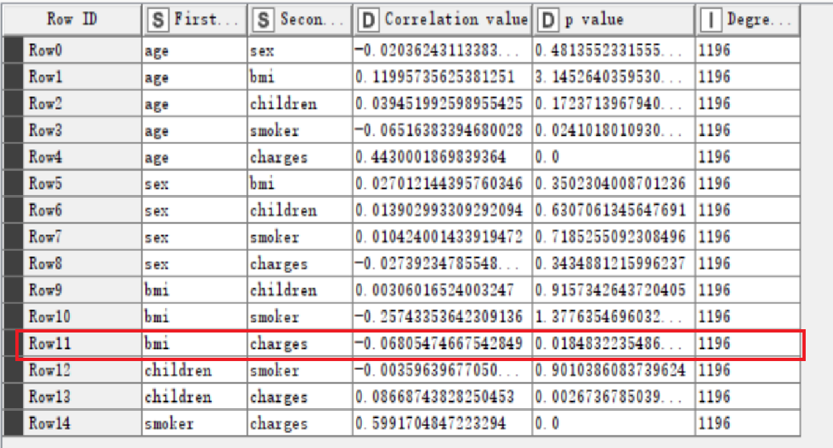
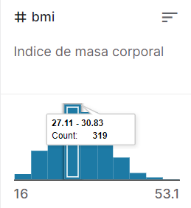
Data Exploration--BMI
In our common sense, BMI briefly indicates one person’s health situation.
Ideally, a healthy person’s BMI should be ranged in [18,24]. However from this statistic chart, most of the people’s BMI concentrate in [27,30], which is a little bit high BMI range.
BMI has a very small linear correlation with charges.
We assume that because the data is concentrated and the average BMI is relatively high, the impact by BMI is weakened.

Slide 9
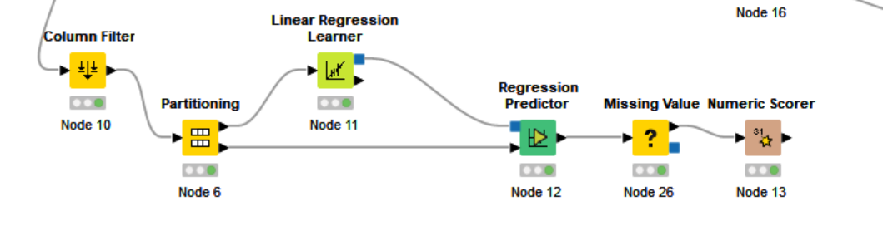
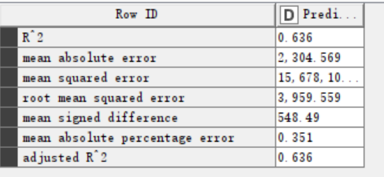
Results
Whether the person is a smoker, and age have the largest effect on the insurance price. In comparison, BMI and sex have a relatively small impact .Region and children nearly have nothing to do with the result.
Current Presenter’s Name

Slide 10
Conclusion
Conclude your project by telling a complete story
Were you able to discover any causal relationship?
If so, what are they?
If not, what else is still needed to foster a good causal relationship?
Current Presenter’s Name

Slide 11
Lessons Learned
Share anything your team find useful/valuable to the successful completion of your project, which could be
Some knowledge points
Some soft skills needed
Is there any obstacle you overcame along the way? How?
If you were to re-do this project (or to work on a similar new project), what would you do differently?
Current Presenter’s Name

Slide 12
Work Distribution
Briefly describe the work distribution within your team, i.e., who did what.
(You are always working as one team. However, we would like to make sure all members contribute to the project the best they can.)
Current Presenter’s Name

Slide 13
Thank you! Questions?

